Slide 1
Introduction To Database

Slide 2

Sujata Batra - sujatabatra@hotmail.com
IT Trainer Since 2000
Conducting Java Training Since 2011
More than 75+ Corporate Clients

Slide 3
Overview of Database Models
Basic Definitions:
Data: Known facts that can be recorded and have an implicit meaning.
Table: A collection of data elements organized in terms of rows and columns.
Record/Tuple: A single entry in a table is called a record or a tuple.
Field: A table consists of several records(row), each record can be broken into several smaller entities known as fields.
Database: A collection of related data.
Database Management System (DBMS): A software package/ system to facilitate the creation and maintenance of a computerized database.
Database System: The DBMS software together with the data itself. Sometimes, the applications are also included.

Slide 4
Overview of Database Models
Database Models:
Define how the logical structure of a database is modeled.
Are fundamental entities to introduce abstraction in a DBMS.
Define how different parts of data are connected to each other and how these are processed and stored inside the system.

Slide 5
Overview of Database Models
Types of Database Models:
Hierarchical model
Network model
Relational model
Object-oriented model

Slide 6
Overview of Database Models (Contd.)
Hierarchical Model:
The data is organized in a tree structure.
There is a hierarchy of parent and child data segments.
A parent can have many children, but a child can have a single parent.
This structure allows one-to-many relationship between two types of data.

Slide 7
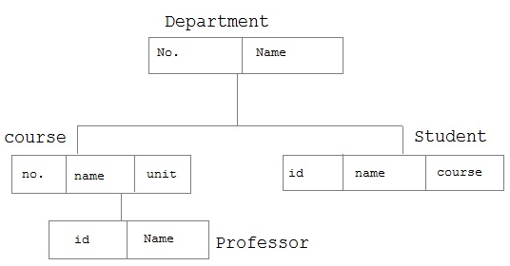
Overview of Database Models (Contd.)
Example of Hierarchical Model:

Slide 8
Overview of Database Models (Contd.)
Network Model:
Entities are organized in a graph, in which some entities can be accessed through several path.
A parent can have multiple children and a child can also have multiple parents.
This structure allows many-to-many relationship between two types of data.

Slide 9
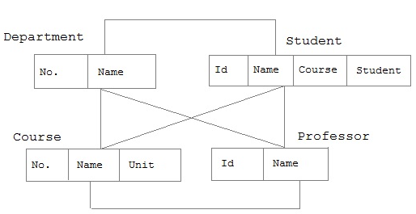
Overview of Database Models (Contd.)
Example of Network Model:

Slide 10
Overview of Database Models (Contd.)
Relational Model:
All data is represented in terms of tuples, grouped into relations.
The tables or relations are related to each other.
A database organized in terms of the relational model is a relational database.
The purpose of the relational model is to provide a declarative method for specifying data and queries.

Slide 11
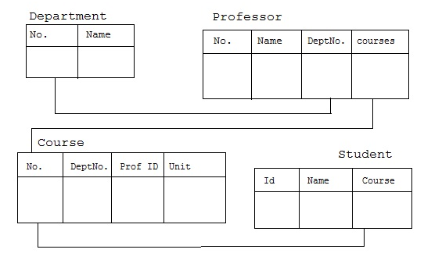
Overview of Database Models (Contd.)
Example of Relational Model:

Slide 12
Overview of Database Models (Contd.)
Object-Oriented Model:
Both data and their relationship are contained in a single structure known as an object.
An object includes information about relationship between the facts within the object, as well as information about its relationship with other objects.
An object is the abstraction of the real- word entity. An object represents only one occurrence of entity.
Attributes describe the property of an object.
Objects that are similar in characteristics are grouped in class.

Slide 13
Overview of Database Models (Contd.)
Example of Object-Oriented Model :
Employee
Name
ID
Salary

Slide 14
Introduction to RDBMS
A Relational Database Management System (RDBMS):
Is a database management system based on relational model introduced by E.F Codd.
Represents data in terms of tuples(rows).
Is used to manage Relational database.
Relational Database:
Is a collection of organized set of tables from which data can be accessed easily.
Consists of number of tables and each table has its own primary key.

Slide 15
Database Keys
Super Key is defined as a set of attributes within a table that uniquely identifies each record within a table. Super Key is a superset of Candidate key.
A Candidate Key:
Is a subset of a super key.
Is a single field or the least combination of fields that uniquely identifies each record in the table. The least combination of fields distinguishes a candidate key from a super key.
Must contain unique values.
Must not contain null values.
Contains the minimum number of fields to ensure uniqueness.
Must uniquely identify each record in the table.

Slide 16
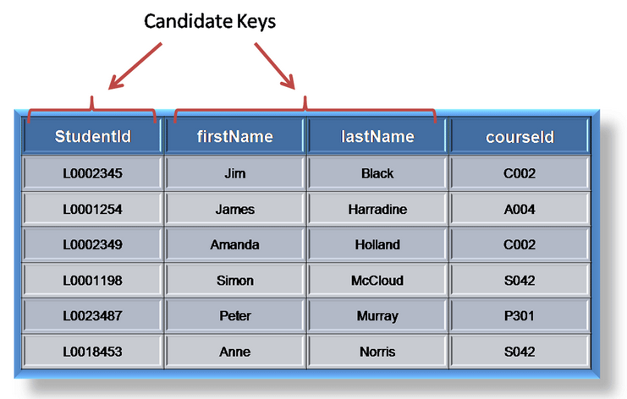
Database Keys
Example of Candidate Key:

Slide 17
Database Keys (Contd.)
Primary Key:
Is a candidate key that is most appropriate to be the main reference key for the table.
Is used throughout the database to help establish relationships with other tables.
Must contain unique values, must never be null and should uniquely identify each record in the table.

Slide 18
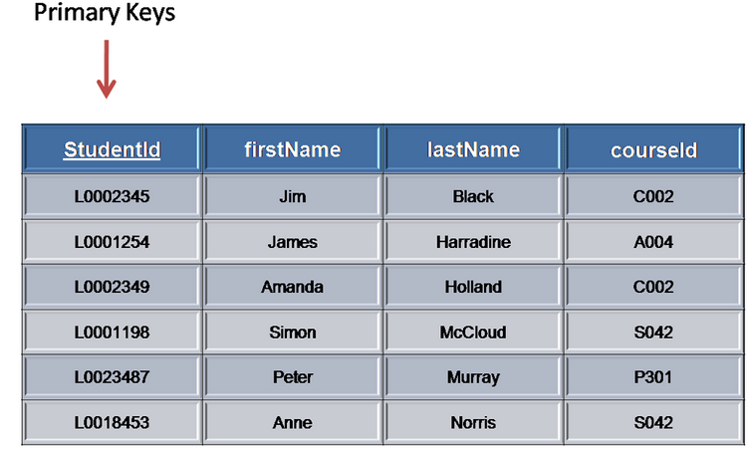
Database Keys (Contd.)
Example of Primary Key:

Slide 19
Database Keys (Contd.)
A foreign Key is generally a primary key from one table that appears as a field in another table, where the first table has a relationship to the second.
For example, if we had a table A with a primary key X that linked to a table B where X was a field in B, then X would be a foreign key in B.

Slide 20
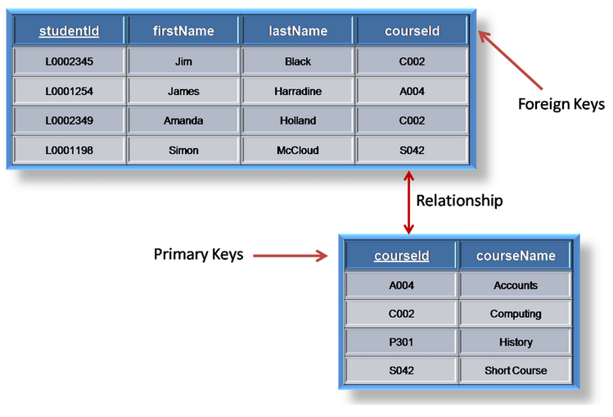
Database Keys (Contd.)
Example of Foreign Key:

Slide 21
Database Keys (Contd.)
Alternate key is any candidate key which is not selected to be the primary key.
Compound key (also called a composite key or concatenated key) is a key that consists of 2 or more attributes.

Slide 22
Normalization
The main goal of Database Normalization is to restructure the logical data model of a database to:
Eliminate redundancy
Organize data efficiently
Reduce the potential for data anomalies
Data Anomalies:
Are inconsistencies in the data stored in a database as a result of an operation, such as update, insertion, and/or deletion.
May arise when have a particular record stored in multiple locations and not all of the copies are updated.
Can be prevented by implementing normalization.

Slide 23
Normalization (Contd.)
Dependencies:
Multivalued Attributes (or repeating groups): Non-key attributes or groups of non-key attributes, the values of which are not uniquely identified by (directly or indirectly) (not functionally dependent on) the value of the Primary Key (or its part).
Example:

Slide 24
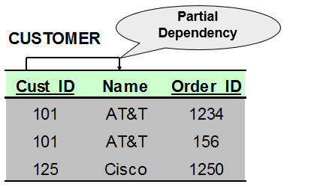
Normalization (Contd.)
Partial Dependency: When a non-key attribute is determined by a part, but not the whole, of a composite primary key.
Example:

Slide 25
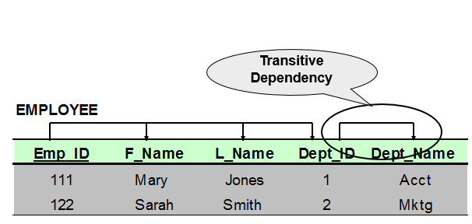
Normalization (Contd.)
Transitive Dependency: When a non-key attribute determines another non-key attribute.
Example:

Slide 26
Normalization (Contd.)
Normalization rules are divided into the following normal forms:
First Normal Form (1NF)
Second Normal Form (2NF)
Third Normal Form (3NF)

Slide 27
Normalization (Contd.)
Requirements to satisfy 1NF:
Each table has a primary key.
The values in each column of a table are atomic (No multi-value attributes allowed).
There are no repeating groups: two columns do not store similar information in the same table.

Slide 28
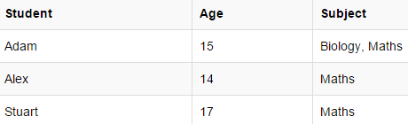
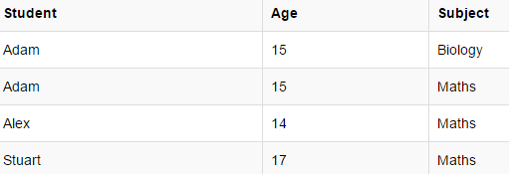
Normalization (Contd.)
Example of 1NF:
The Student Table

Slide 29
Normalization (Contd.)
Requirements to satisfy 2NF:
All requirements for 1NF must be met.
Redundant data across multiple rows of a table must be moved to a separate table.
The resulting tables must be related to each other by use of foreign key.

Slide 30
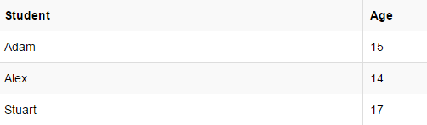
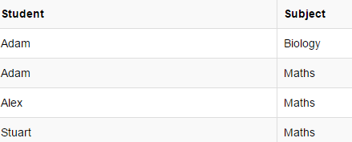
Normalization (Contd.)
Example of 2NF:
New Student Table
New Subject Table

Slide 31
Normalization (Contd.)
Requirements to satisfy 3NF:
All requirements for 2NF must be met.
Eliminate fields that do not depend on the primary key;
That is, any field that is dependent not only on the primary key but also on another field must be moved to another table.

Slide 32
Normalization (Contd.)
Example of 3NF:
Student_Detail Table
New Student_Detail Table
Address Table

Slide 33
ER Diagrams
ER Diagrams:
Were proposed by Peter Chen in 1976.
Are widely used in database design.
Represent conceptual level of a database system.
Describe entities and their relationships in high level.

Slide 34
ER Diagrams (Contd.)
Basic Concepts Required for ER Diagrams:
Entity – An abstraction of similar things, e.g. cars, students, and employees.
An entity set contains many entities.
Attributes: Common properties of the entities in entity sets.
Relationship – Specifies the relations among entities from two or more entity sets.

Slide 35
ER Diagrams (Contd.)
Symbols and Notations
Symbols | Notations
 | Entity
 | Relationship
 | Attribute

Slide 36
ER Diagrams (Contd.)
Symbols | Notations
 | Weak Entity
 | Weak Entity Relationship
 | Multivalued Attribute

Slide 37
ER Diagrams (Contd.)
Symbols | Notations
 | Key Attribute
 | Composite Attribute

Slide 38
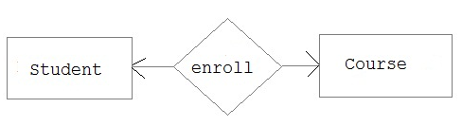
ER Diagrams (Contd.)
Types of relationship that exist between Entities:
Binary Relationship: Means relation between two Entities.
Recursive Relationship: When an Entity is related with itself.
Ternary Relationship: Relationship of degree three.
Binary relationship is further divided into three types:
One-to-one

Slide 39
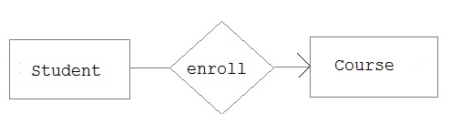
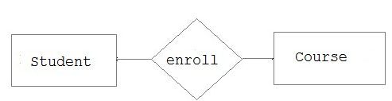
ER Diagrams (Contd.)
One-to-many
Many-to-one

Slide 40
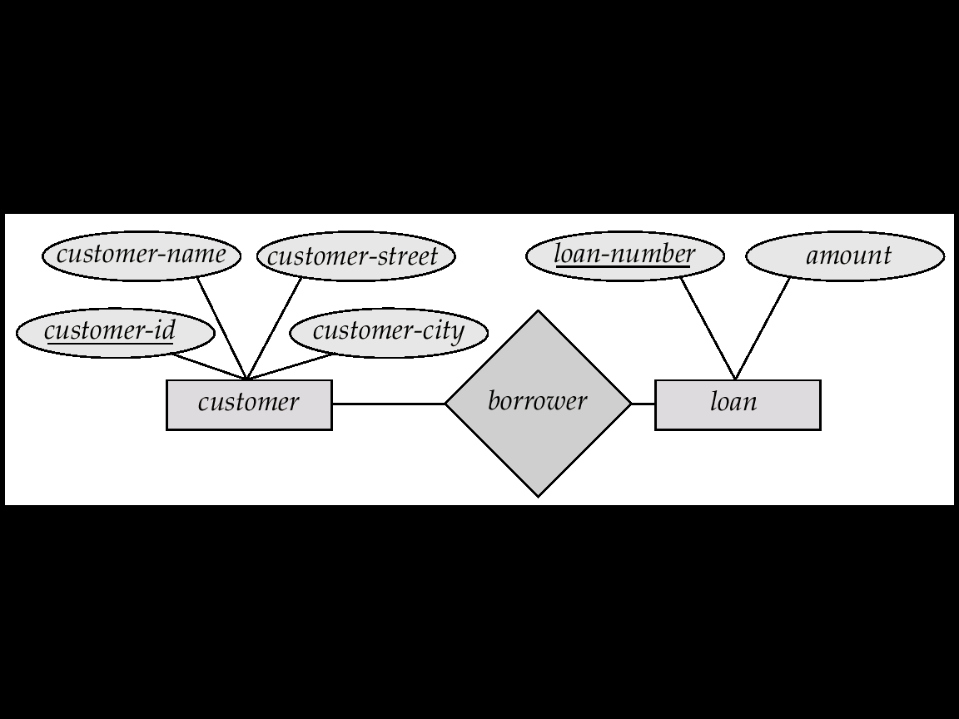
ER Diagrams (Contd.)
An ER Diagram:

